Slide 1

E- FIESTA
Silver Oak College of Engineering and Technology Ahmedabad – 382481 Team Members
Aishvwarya N. Iyer 120770107009
Gayathree N. Iyer 120770107042 Project Guide Ms. Khyati Patel Asst Prof. Computer Engineering

Slide 2

INTRODUCTION
iOS is a mobile operating system created and developed by Apple Inc. and distributed exclusively for apple hardware.
It not only manages power efficiently but also delivers outstanding battery life. iOS even ensures that performance and battery life don’t suffer even if you are multitasking.
iPhone and iOS are made to be used around the world. The user interface is localized into over 30 languages, and you can easily switch between them.

Slide 3

E- Fiesta
This iphone application is very useful to the users who are going to arrange a party, marriage, birthday celebration, reception etc.
User need not approach the caterers at his office. Instead, users can see the food items and make a package of food items.
This app is also useful to determine the total cost with number of guests.

Slide 4
OBJECTIVE
The main objective of this application is to ease the catering need of the customers in various events and celebrations.
User can see predefined packages- Silver and Gold and order that.
Customization of the package wherein users can decide a package.
User can give feedback, complaint, suggestion to the catering company.

Slide 5
SCOPE
The documentation and designing was completed in semester(VII) and coding , testing part was done in the current semester(VIII).
It includes on time delivery of food, hygienic & delicious food, sufficient quantity of food, efficient waiters and cook.

Slide 6
HARDWARE AND SOFTWARE REQUIREMENTS
Hardware Requirement
Mobile OS: iOS/ iPHONE
20 MB free space to run an application
RAM : 512 MB RAM (minimum)
Software Requirement
Programming language: Objective- C
Front End: Interface Builder
Back End: SQLite 3.8.10.2
Xcode 7 toolkit

Slide 7
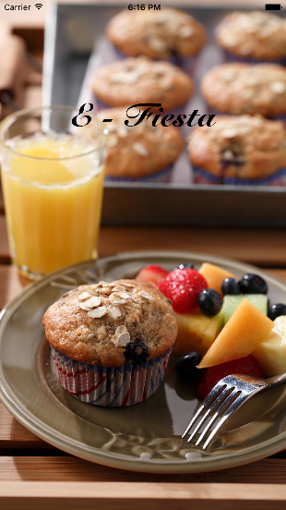
SPLASH SCREEN

Slide 8
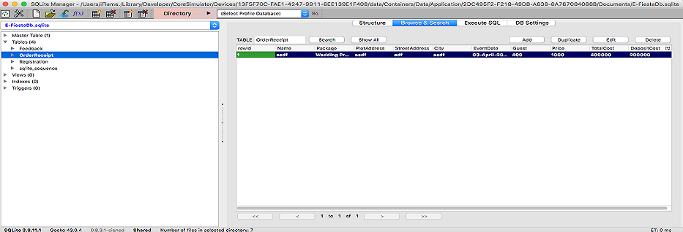
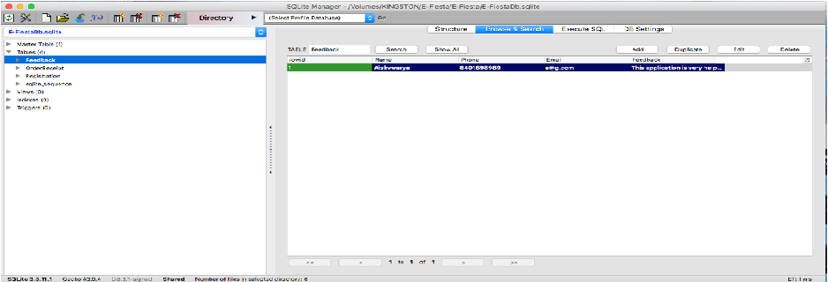
Database for Order Receipt and Feedback

Slide 9
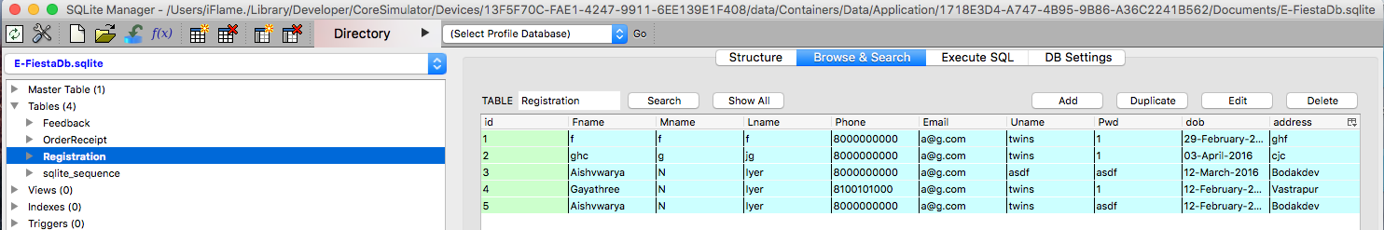
Database for Registration

Slide 10
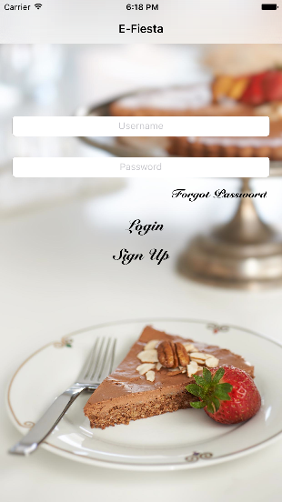
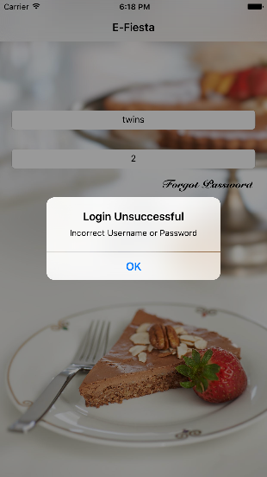
LOGIN PAGE

Slide 11
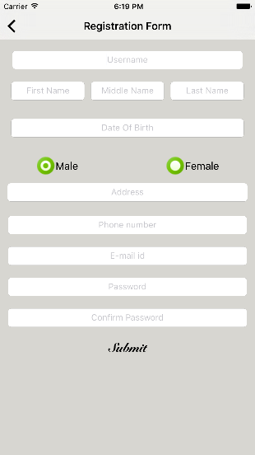
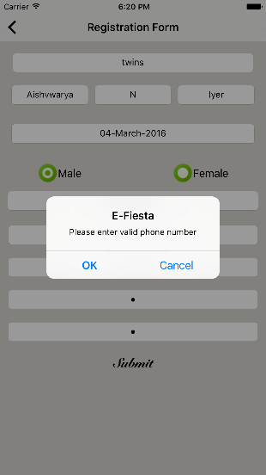
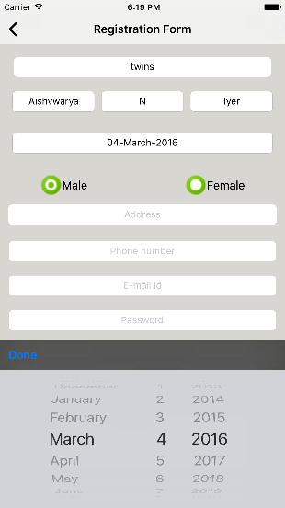
REGISTRATION FORM

Slide 12
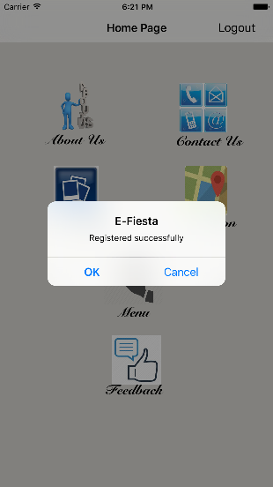
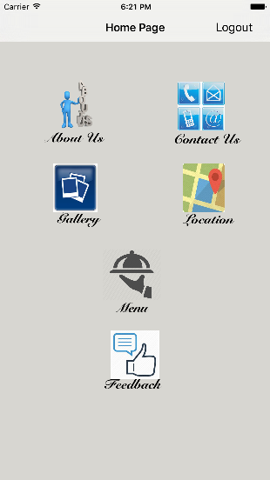
HOME PAGE

Slide 13
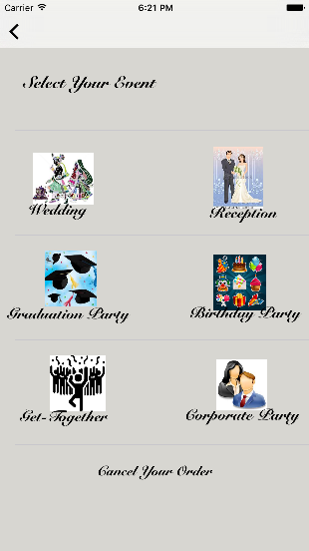
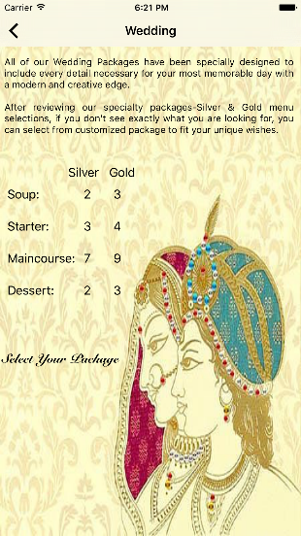
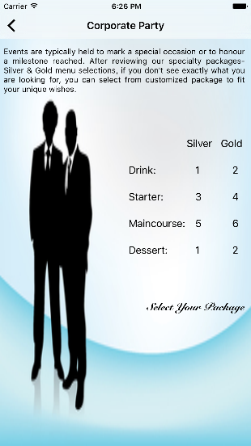
EVENTS

Slide 14
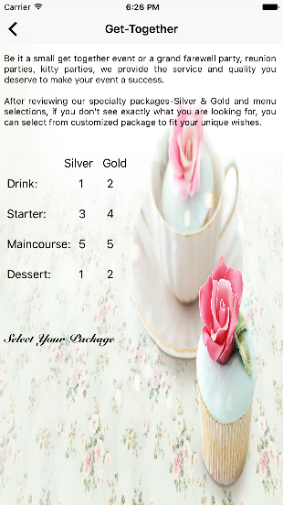
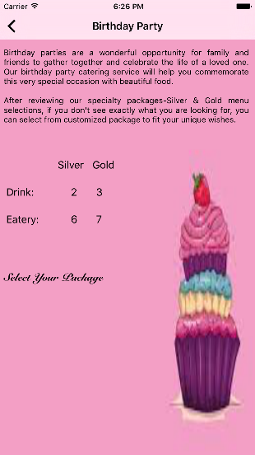
OTHER EVENTS

Slide 15
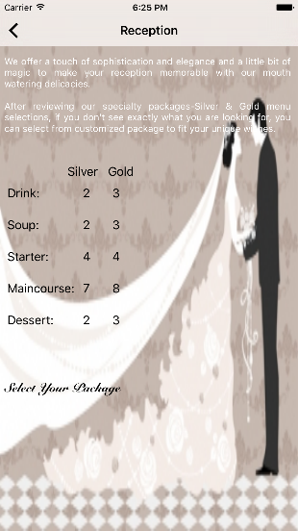
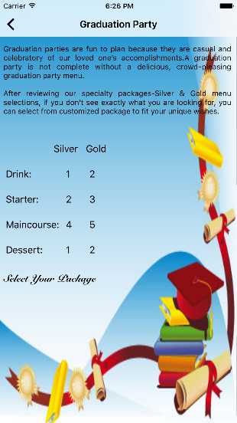
OTHER EVENTS

Slide 16
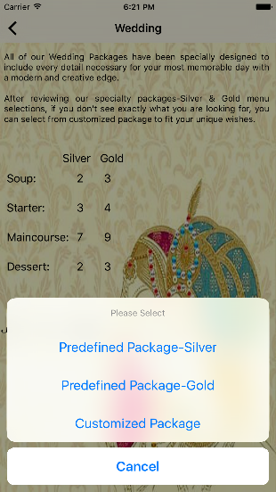
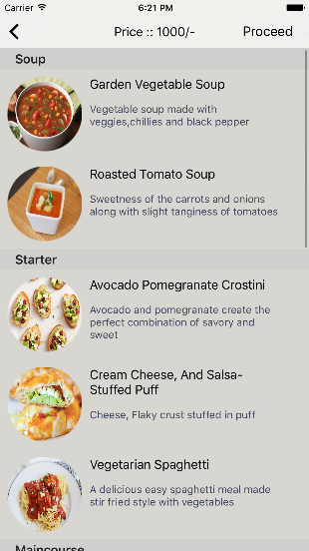
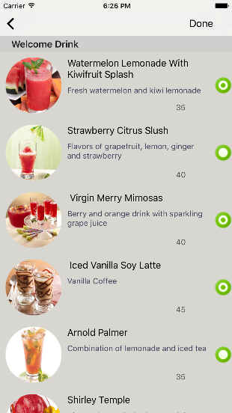
PREDEFINED PACKAGE AND CUSTOMIZED PACKAGE

Slide 17
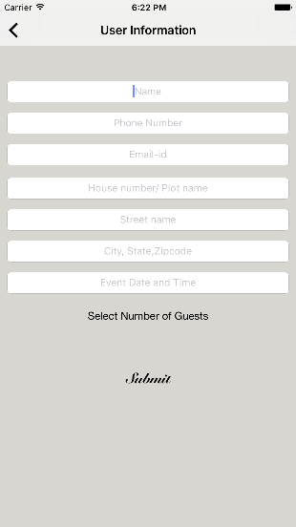
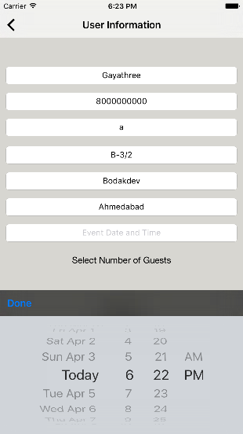
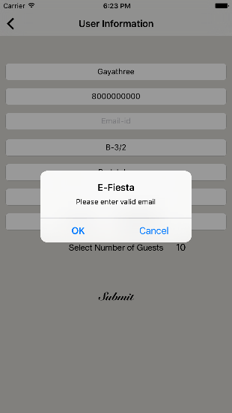
USER INFORMATION

Slide 18
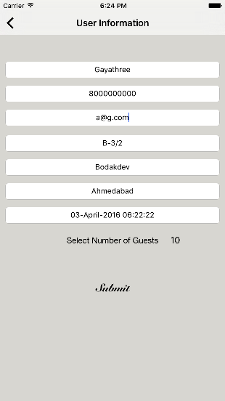
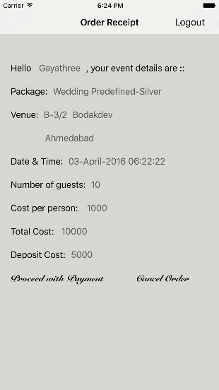
ORDER RECEIPT

Slide 19
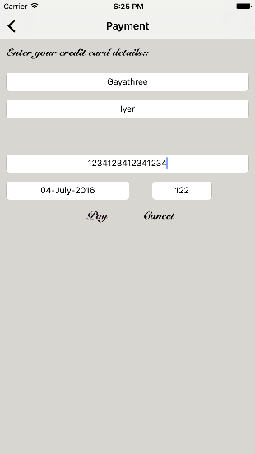
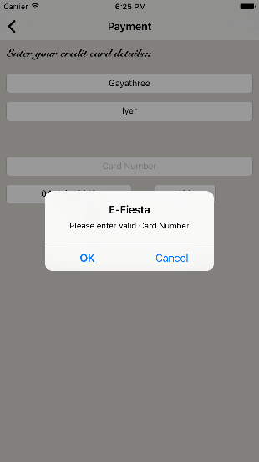
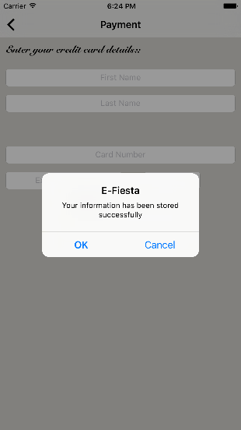
PAYMENT

Slide 20
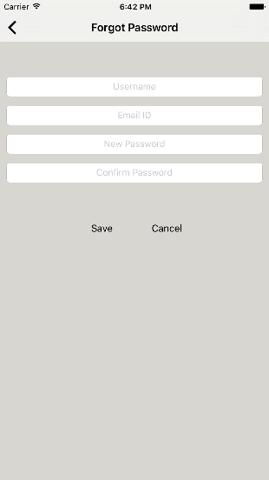
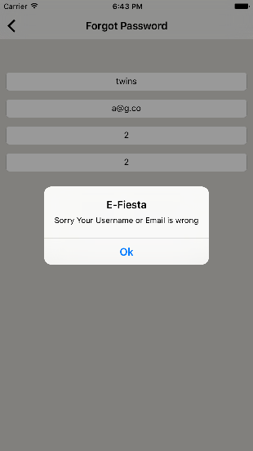
FORGOT PASSWORD

Slide 21
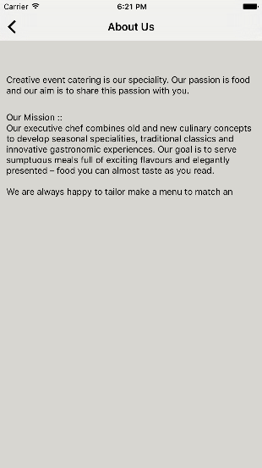

ABOUT US AND CONTACT US

Slide 22
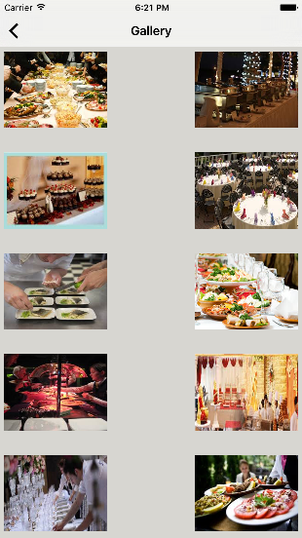
GALLERY

Slide 23
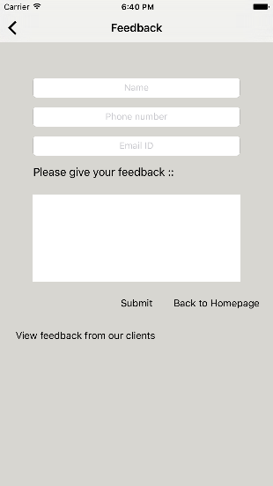
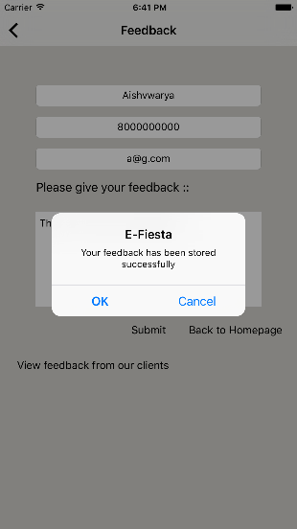
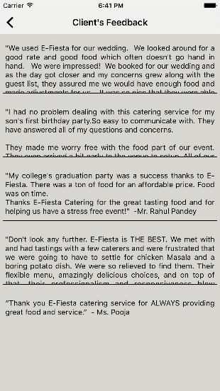
FEEDBACK

Slide 24
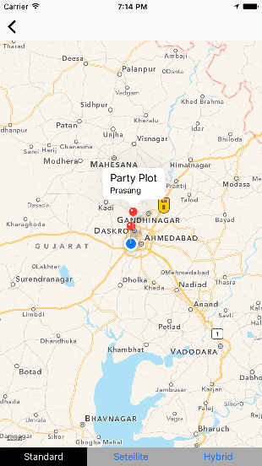
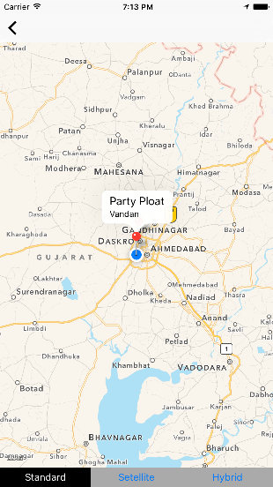
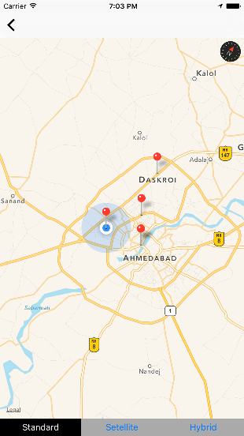
LOCATION

Slide 25
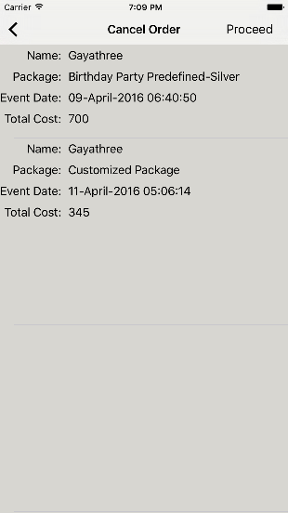
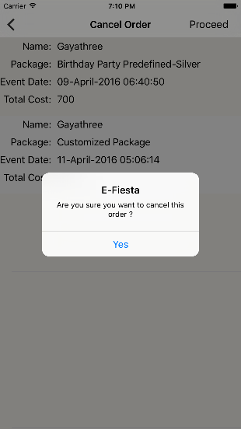
CANCEL ORDER

Slide 26
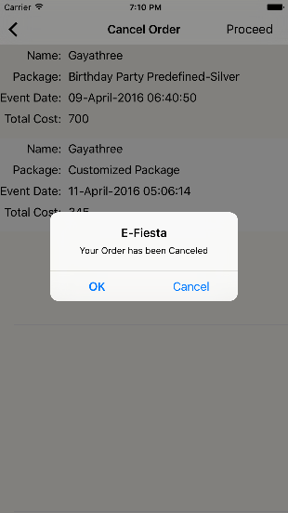
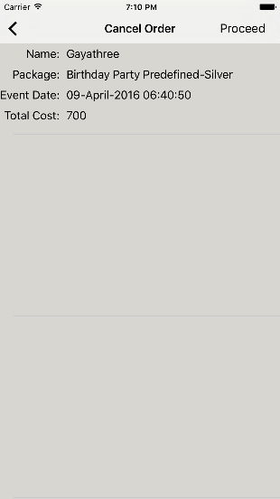
CANCEL ORDER

Slide 27
CONCLUSION
This application is very useful for the users who are going to arrange a wedding, reception, birthday party, graduation party, corporate party, Get-together. User need not approach the caterers at his office instead users can see the food item and order a predefined package or customize their own package.
User can view two predefined packages- Gold and Silver.
There is a customize package.
Users can give feedback.
Users can cancel their previous order.
Hence this application is very useful for catering food requirements in various events.

Slide 28
REFERENCE
www.digitalcarryout.com
www.cateringsystems.co.uk/
Fundamentals of Software Engineering by Rajib Mall, 3rd edition.
iOS Programming: The Big Nerd Ranch Guide (4h edition) by Conway, Hillegass
& Keur.
iOS 7 Programming Fundamentals by Neuberg.

Slide 29

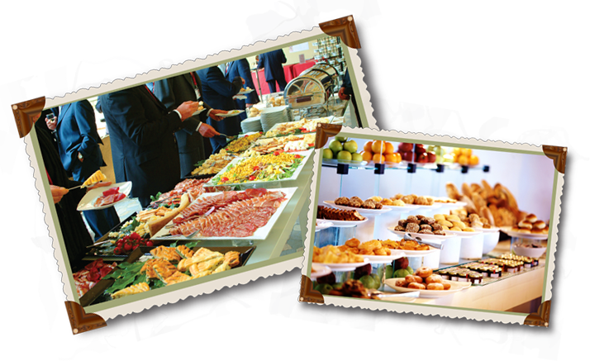
We make your event

Slide 30

Thank You

